Slide 1

Blinkit Data Aanalysis Report

Slide 2
Problem Statement
Blinkit aims to optimize its sales strategies and improve overall performance. The company seeks to understand the key drivers of sales, identify areas of improvement, and develop targeted strategies to enhance customer satisfaction and increase profitability.

Slide 3
Insights
Total Sales and Average Sales:
Total Sales: $1.2M
Average Sales: $141
Insight: While the total sales are substantial, the average sales per transaction are relatively low. This suggests a high volume of low-value transactions.

Slide 4

Sales by Fat Content:
Low Fat: 35.15%
Regular: 64.19%
Insight: There is a slight preference for regular fat content items over low-fat items.

Slide 5

Item Type Distribution:
Various item types such as Fruits, Snacks, Household, etc., have varying sales contributions. Fruits and Snacks seem to be popular items.

Slide 6
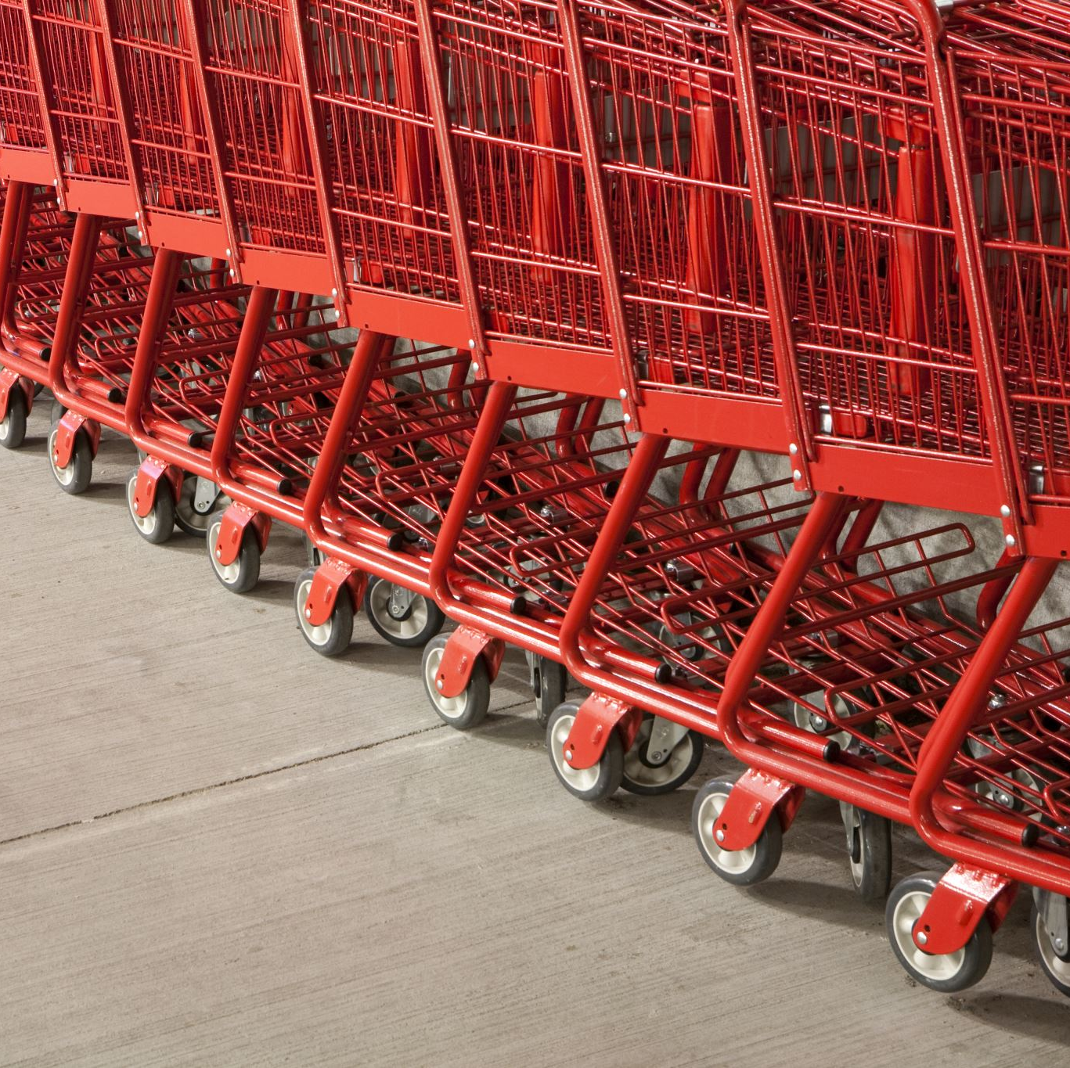
Outlet Size Distribution:
High: 1.75%
Medium: 3.63%
Small: 94.62%
Insight: The majority of outlets are small, which might indicate a preference for smaller, possibly more convenient, stores.

Slide 7
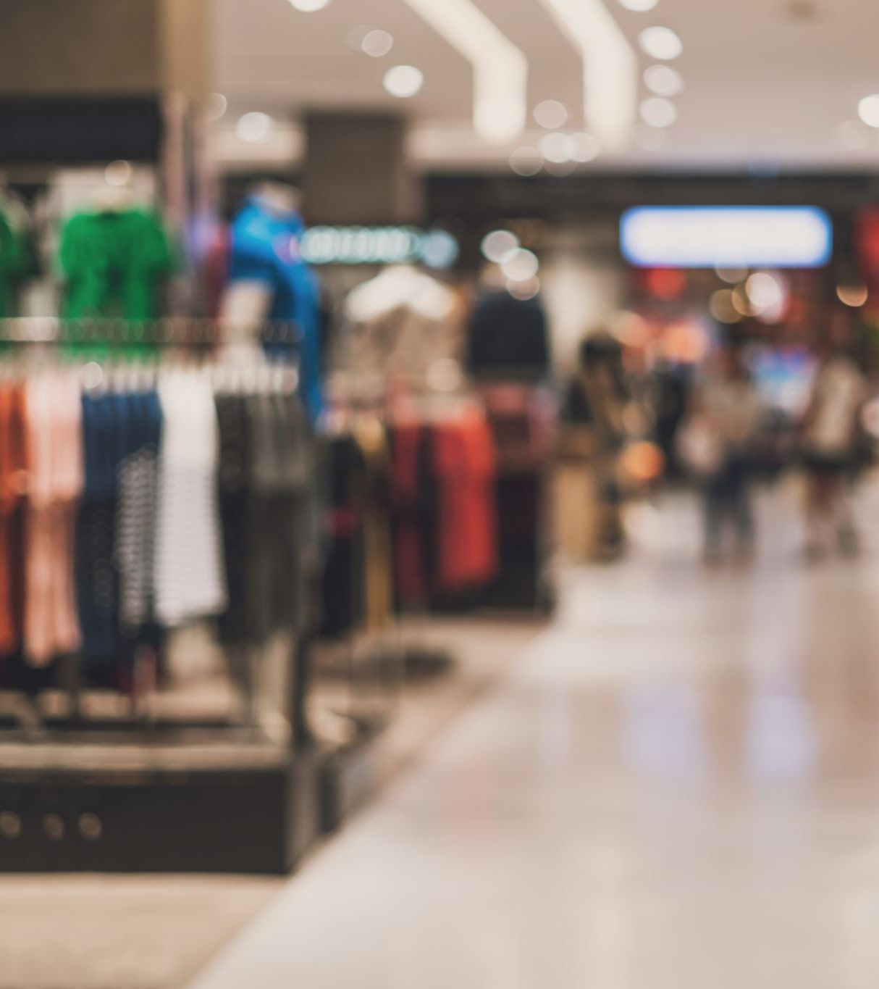
Total Sale by Outlet Establishment Year:
There is a peak in sales around 2018, suggesting that outlets established around this time have higher sales.

Slide 8
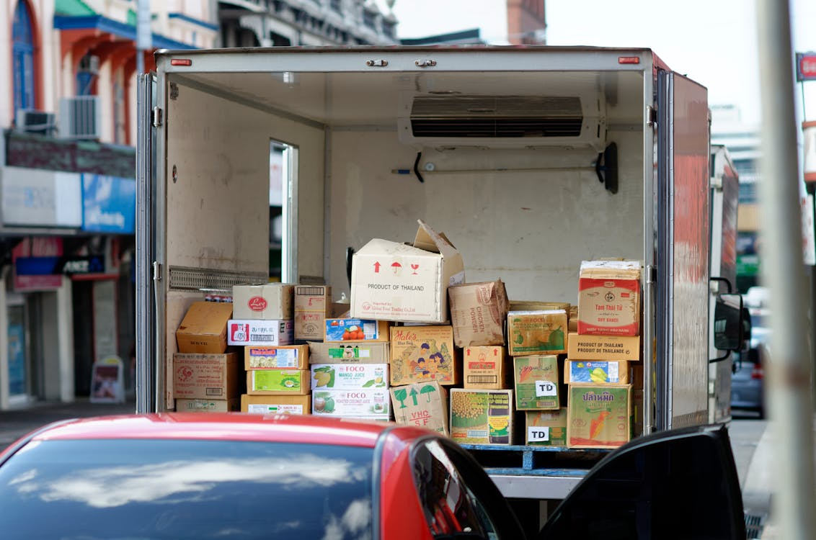
Total Sale by Outlet Location Type:
Tier 1: $336K
Tier 2: $393K
Tier 3: $472K
Insight: Tier 3 outlets have the highest sales, indicating that these locations might be more profitable

Slide 9
Areas of Improvement
Increase Average Sales:
Focus on strategies to increase the average sales per transaction. This could involve promoting higher-value items or bundles.
Optimize Outlet Size:
Analyze the performance of different outlet sizes. While small outlets dominate, exploring the feasibility of medium-sized outlets in high-potential areas could be beneficial.
Promote Low-Fat Items:
Increase the visibility and promotion of low-fat items to cater to health-conscious customers.
Enhance Visibility of High-Performing Items:
Items with higher sales should be given more visibility in stores to encourage repeat purchases.

Slide 10
Recommendations
Targeted Promotions:
Implement targeted promotions for items with high sales potential but lower visibility. Use data on item type and fat content to tailor promotions.
Expand Medium-Sized Outlets:
Consider expanding into medium-sized outlets in areas where sales are high but space is limited. This could provide more room for inventory and better customer experience.
Focus on Tier 3 Locations:
Invest more in Tier 3 locations, as they show the highest sales. This could involve opening new outlets or enhancing existing ones.
Enhance Item Visibility:
Use data on item visibility to place high-performing items in high-traffic areas within the outlets.
Customer Feedback:
Collect and analyze customer feedback to understand preferences better. Use this information to adjust inventory and promotions.
Leverage Technology:
Use technology to track item performance and customer behavior. Implementing a robust analytics platform can provide real-time insights to optimize sales strategies.

Slide 11

Conclusion
By focusing on these insights, areas of improvement, and recommendations, Blinkit can enhance its sales strategies, optimize outlet performance, and better cater to customer preferences. This comprehensive approach will help Blinkit achieve its goals of increasing profitability and customer satisfaction.

